Slide 1
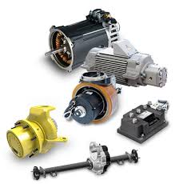
Electrical Drives

Slide 2
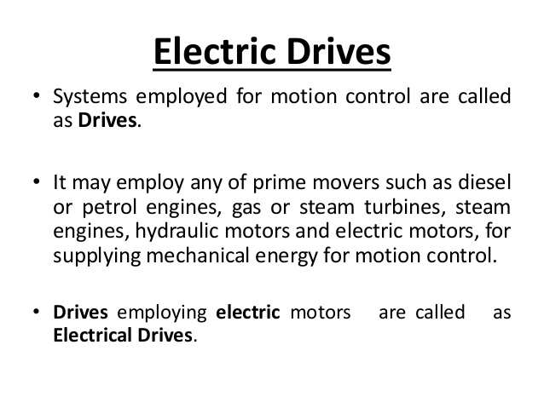

Slide 3
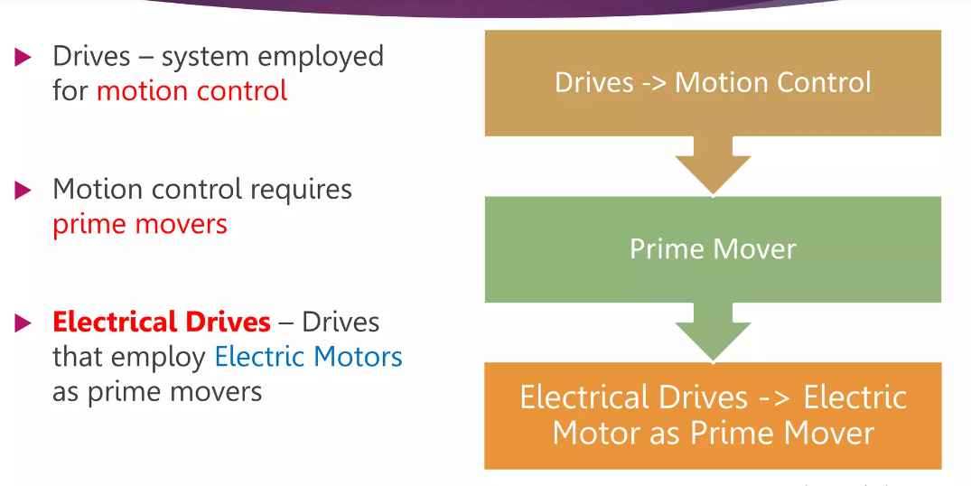

Slide 4
Advantages of Electrical Drives
They have flexible control Characteristics
Available in wide range of Torque , speed , power
High efficiency for electric motors,
- low no load loss, short time overloading capacity, Long life , low noise , low maintenance , cleaner
4. Adaptable to any operating Conditions
- Explosive, Radio active, Liquids, Vertical Mountings
5.Do not pollute environment
6.Can operate in any four Quadrant of speed torque plane
7.No need of refuel and warm up the motor
8.They are powered by electrical energy which has number of advantages over any other form of energy

Slide 5
Advantages of Electrical Drives
Electric drives are environment friendly as they do not produce smoke, fumes, ash, etc. Therefore, electric drives are most suited for the underground and tube railways.
Electric drives are flexible because their performance can be controlled effectively by using electronic devices such as SCRs, IGBTs and microcontrollers.
Available in wide range of torque, speed and power.
Compact in size; electric drives occupy less space.
Do not require warm-up time; they can be started immediately.
Electric drives can be remote controlled.
A reliable source of drive.
Powered by electrical energy which has a number of advantages over other sources of energy.

Slide 6
Advantages of Electrical Drives
Adaptable to different operating conditions such as submerged in liquid, explosive chemical or mining environment, radioactive environment, etc.
Electric drives have high schedule speed, high traffic handling capacity and hence require less terminal space.
Require less maintenance cost and less maintenance time. Electric drives are economical.

Slide 7
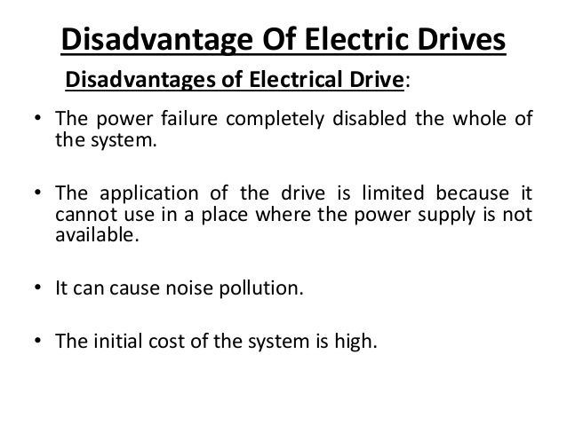

Slide 8
disAdvantages of Electrical Drives
The capital cost of installing an electric drive is high.
Electric drives are suitable only on electrified tracks.
Electric drives require additional control circuitry.
Sometimes, electric drives can cause noise pollution.
Electric drives have poor dynamic response.
Power failure can completely disable an electric drive.
The output power obtained from an electric drive is low.

Slide 9
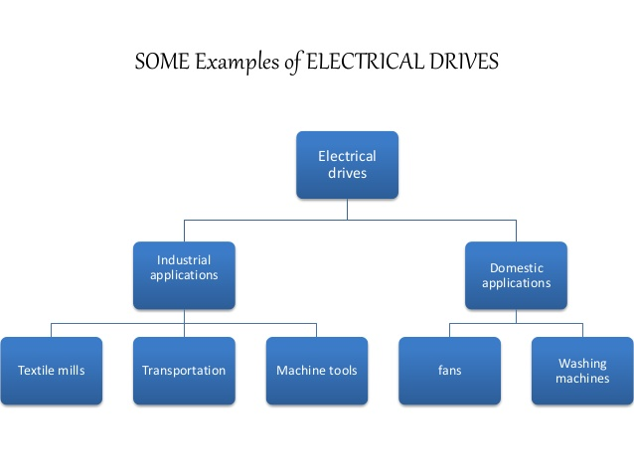

Slide 10
Applications
Paper mills
Cement Mills
Textile mills
Sugar Mills
Steel Mills
Electric Traction
Petrochemical Industries
Electrical Vehicles

Slide 11
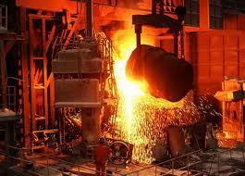
motors for particular applications
Steel rolling mills
Driving motor is required to withstand severe and rapid torque and speed change
SCR controlled DC shunt motor is used

Slide 12
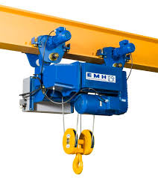
motors for particular applications
Punches, Cranes, Hoists and Shears
This loads taken intermitted loads
Started, stopped and frequent starting and stopping, reversing
High starting torque
nearly 3 times of full load
High slip Induction motors and
dc series motors are used

Slide 13
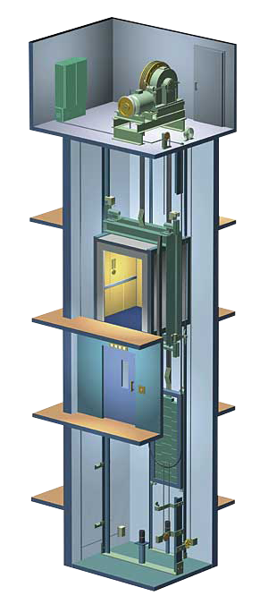
motors for particular applications
Lifts
High starting Torque is required
Smooth uniform acceleration, quiet running
Frequent start and stopes
DC shunt motors, AC Slip ring induction motor or
high starting toque squirrel cage induction motors
are used

Slide 14
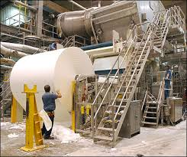
motors for particular applications
Paper mill Drives
Accurate speed control
SCR powered DC shunt motors, for clutches induction motors are used.
Pumps Blowers and compressors
Starting torque, constant speed
and good speed regulation
Induction motors with speed
controlled mechanism is used

Slide 15
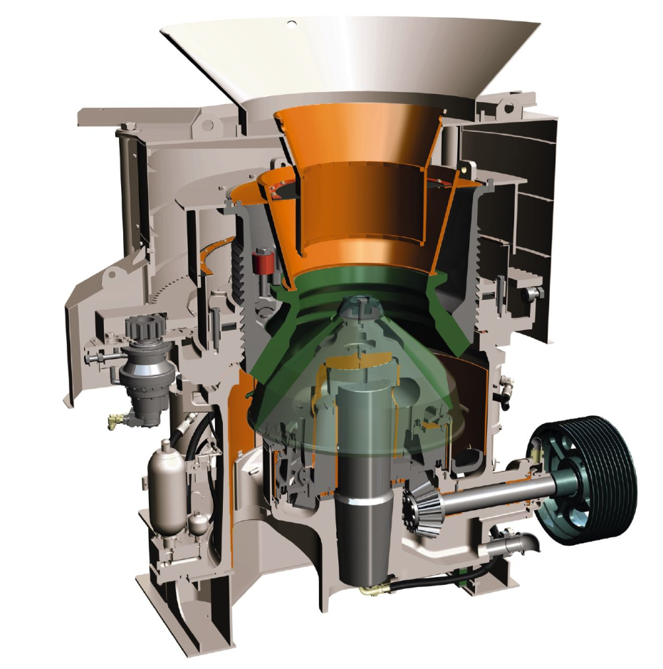
motors for particular applications
Reciprocating pumps, crushers and ball mills
2 or 3 time of full load torque is required for starting
High inertia
Friction at stand still
Induction motors are used
Electric traction
DC series motors are used

Slide 16
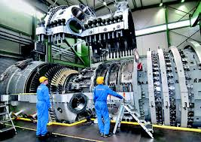
motors for particular applications
House hold applications
Single phase induction motors are used
Ships
Synchronous or Slip ring
motors for large ships
Squirrel cage for small ships

Slide 17
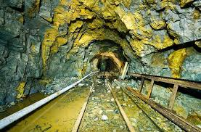
motors for particular applications
Printing Machines
Squirrel cage motor,dc compound,ac slip ring motors
Textile machinery
Three phase induction motors
Mines
3 phase squirrel cage motor
with star delta auto transformer starters used
For high starting torque Slip
ring or dc motors are used
Flame proof construction

Slide 18
Block Diagram of Electrical Drives
Source
Power Modulators
Motors
Load
Control Unit
Sensing Unit
Input Command

Slide 19
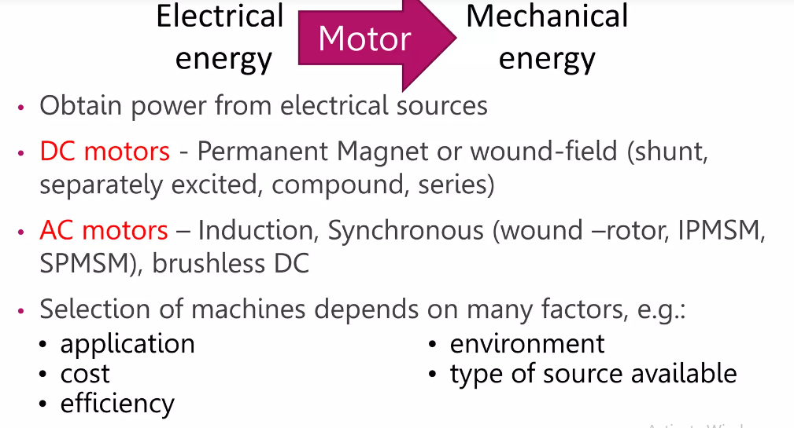

Slide 20
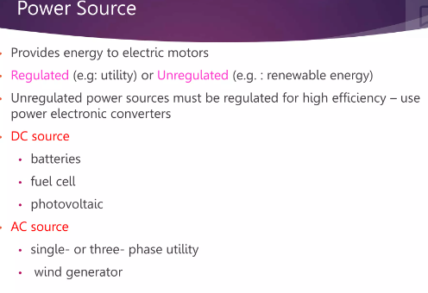

Slide 21
Electrical Sources
Very low power drives are generally fed from single phase sources. Rest of the drives is powered from a 3 phase source. Low and medium power motors are fed from a 400v supply. For higher ratings, motors may be rated at 3.3KV, 6.6KV and 11 KV. Some drives are powered from battery.

Slide 22
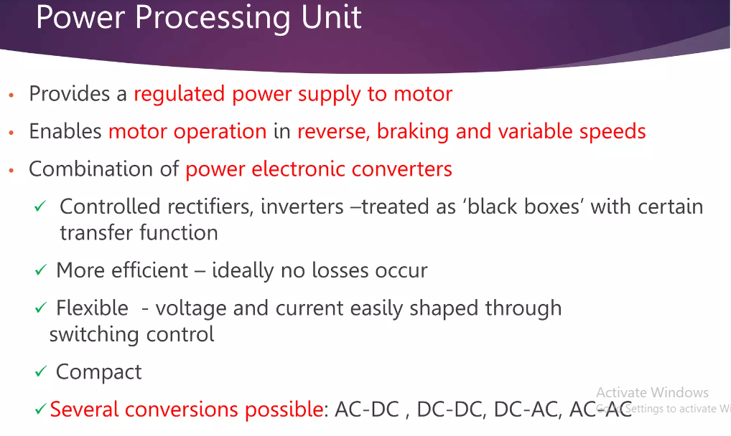

Slide 23
A modern variable speed electrical drive system has the following components
Electrical machines and loads
Power Modulator
Sources
Control unit
Sensing unit
Electrical Machines
Most commonly used electrical machines for speed control applications are the following
DC Machines
Shunt, series, compound, separately excited DC motors and switched reluctance machines.
AC Machines
Induction, wound rotor, synchronous, PM synchronous and synchronous reluctance machines.
Special Machines
Brush less DC motors, stepper motors, switched reluctance motors are used.

Slide 24
Power Modulators
Functions:
Modulates flow of power from the source to the motor in such a manner that motor is imparted speed-torque characteristics required by the load .
During transient operation, such as starting, braking and speed reversal, it restricts source and motor currents with in permissible limits.
It converts electrical energy of the source in the form of suitable to the motor .
Selects the mode of operation of the motor (i.e.) Motoring and Braking.

Slide 25
Types of Power Modulators
In the electric drive system, the power modulators
can be any one of the following
Controlled rectifiers (ac to dc converters)
Inverters (dc to ac converters)
AC voltage controllers (AC to AC converters)
DC choppers (DC to DC converters)
Cyclo converters (Frequency conversion)

Slide 26
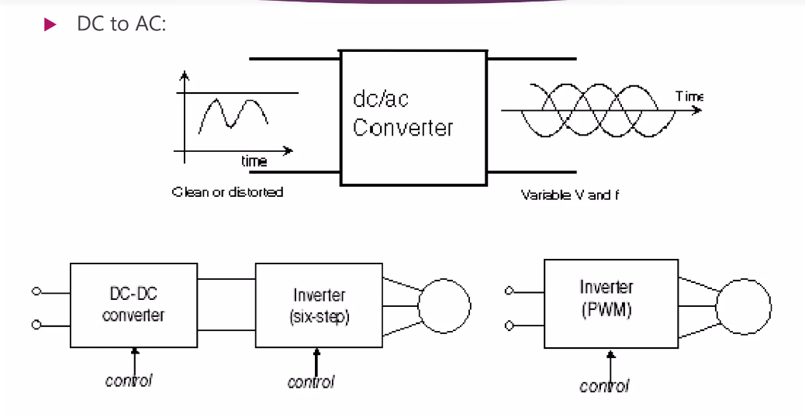

Slide 27
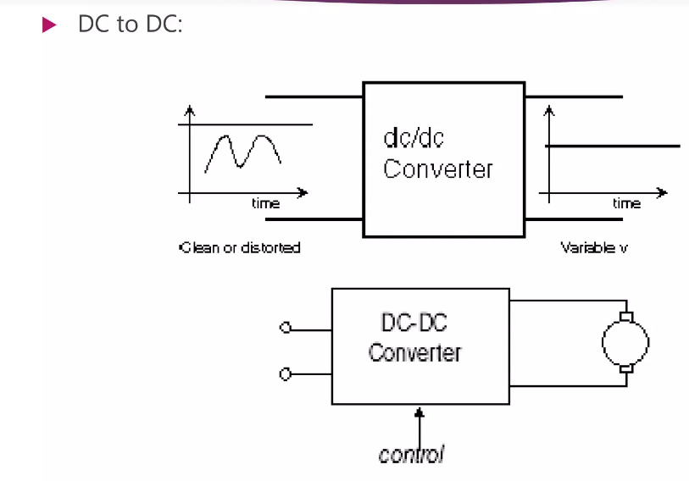

Slide 28
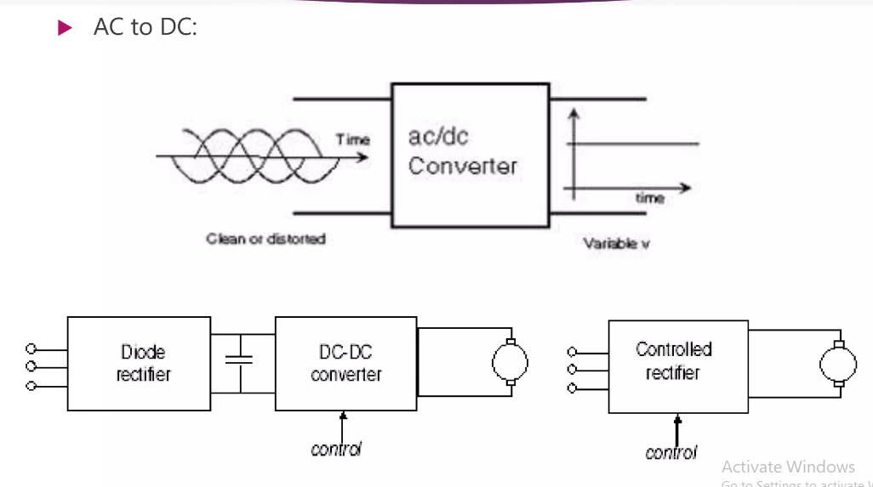

Slide 29
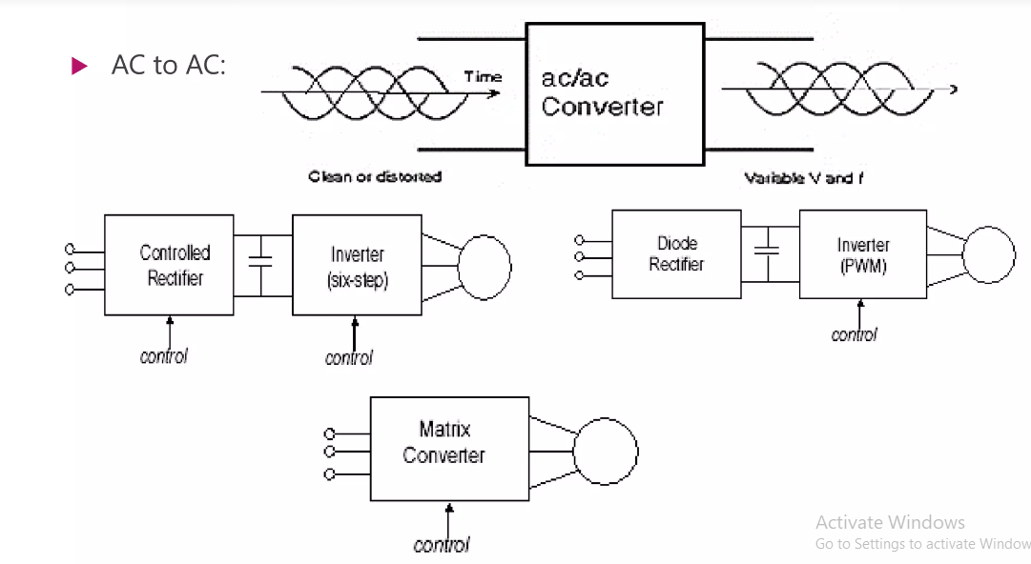

Slide 30
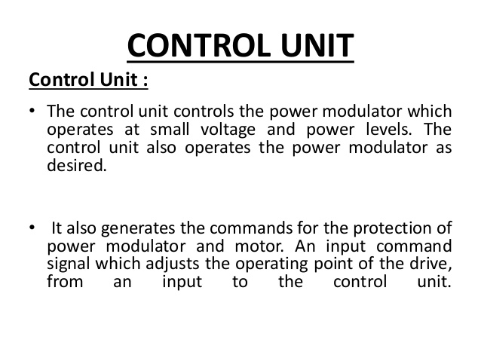

Slide 31

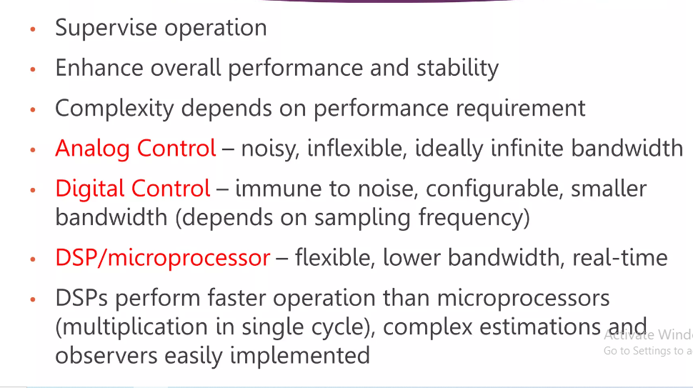

Slide 32
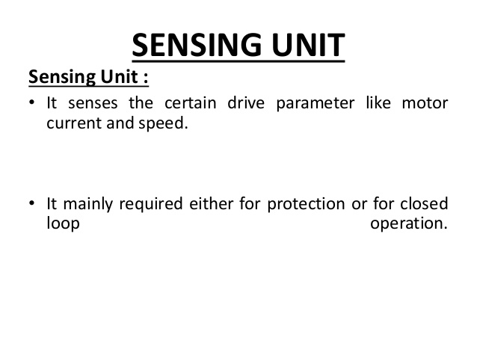

Slide 33
Sensing Unit
Speed Sensing (From Motor)
Torque Sensing
Position Sensing
Current sensing and Voltage Sensing from Lines or from motor terminals
From Load
Torque sensing
Temperature Sensing

Slide 34
Factors affecting Selection of Motors
The basic elements of the electric drive are the electric motor, the transmission and the electrical control system.
Electric drive is becoming more and more popular for its simplicity, easy and smooth control, reliability and long life.
Here the electric motor is very important one in the drive equipment. Nowadays there are different types of motors available with different features. So we have to select the motor as per our requirements.
Some factors are to be considered while selecting the motor in the drives. Those factors are as follows:
Nature of the drive
  Whether the particular motor is going to drive individual machine or a group of machines
Steady State Operating conditions requirements
Nature of speed torque characteristics, speed regulation, speed range, efficiency, duty cycle, quadrants of operation, speed fluctuations if any, ratings etc.
Cont….

Slide 35
Factors affecting Selection of Motors
Transient operation requirements
Values of acceleration and deceleration, starting, braking and reversing performance.
Requirements related to the source
Types of source (AC or DC source) and its capacity, magnitude of voltage, voltage fluctuations, power factor, harmonics and their effect on other loads, ability to accept regenerative power
Nature of load
    Whether the load requires light or heavy starting torque
    Whether load torque increases with speed remain constant
    Whether the load has heavy inertia which may require longer straight time
Electrical characteristics of motor
    Starting characteristics,
    Running characteristics,
    speed control and
    Braking characteristics
Cont….

Slide 36
Factors affecting Selection of Motors
Size, rating and duty cycle of motors
  Whether the motor is going to the operator for a short time or whether it has to run continuously intermittently or on a variable load cycle
Mechanical considerations
  Type of enclosures, type of bearings, transmission of drive and Noise level.
  Due to practical difficulties, it may not possible to satisfy all the above considerations.
  In such circumstances, it is the experience and knowledge background which plays a vital role in the selection of the suitable drive.
Capital and running cost
Maintenance requirements
Space and weight restrictions
Environment and location
Reliability

Slide 37
Factors affecting Selection of Motors
The following points must be given utmost important for the selection of motor. The factors are:
Nature of the mechanical load driven
Matching of the speed torque characteristics of the motor with that of the load
Starting conditions of the load.

Slide 38
Nature of the Electric Supply
The electric supply available may be 3-phase a.c. or single phase a.c. or d.c.
In case of three phase a.c. supply is available, polyphase induction motors, squirrel cage type for small ratings and slip ring type for higher ratings may be used.
In case where speed variation is required these can not be used, so pole changing motors or motors with stepped pulleys may be used.
Where accurate control of speed is required, Scharge motors may be used.
Use of single phase motors is limited to small loads only because of their limited outputs.
D.C. motors are not used so widely as a.c. motors. There are several reasons for this, some of those reasons are given below:
1. Additional equipment is required for converting existing a.c. supply into d.c. supply.
2. D.C. motors have commutators that are subject to trouble and resulting in sparking, brush wear, arc over and the presence of moisture and destructive fumes in the surrounding air.
3. D.C. motors are generally more expensive than a.c. machines for similar working conditions.
In some cases, such as in electric excavators, steel mills and cranes, the speed control is important so dc supply is used by converting a.c. supply in to d.c. supply.

Slide 39
Classification of Electric Drives
According to Mode of Operation
Continuous duty drives
Short time duty drives
Intermittent duty drives
According to Means of Control
Manual
Semi automatic
Automatic
According to Number of machines
Individual drive
Group drive
Multi-motor drive
According to Dynamics and Transients
Uncontrolled transient period
Controlled transient period
According to Methods of Speed Control
Reversible and non-reversible
uncontrolled constant speed.
Reversible and non-reversible step speed control.
Variable position control.
Reversible and non-reversible smooth speed control

Slide 40
Types of Electric Drives
The various types of electric drives used in industry may be divided into three types. They are
1. Group drive
2. Individual drive
  3. Multi-motor drive
Group Drive:
The group drive is a drive in which a single electric motor drives a group of working machines.
It comprises of a single lengthy shaft, to the shaft the different working machines are attached by means of pulleys and conveyor belts. Sometimes group drive is also known as LINE SHAFT DRIVE.
Group drive is often used in industries where successive operations are required like car manufacturing industries etc..

Slide 41
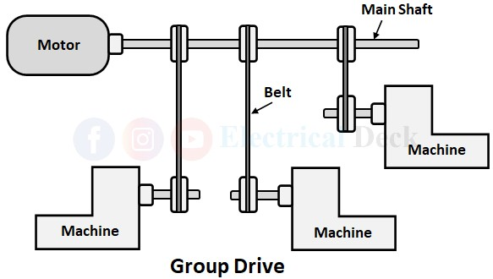
Types of Electric Drives
Advantages:
In group drive we require one machine with high capacity for to control the group of machines. i.e. here the cost of the one machine with high capacity is less than the number of machines. i.e. cost of a single 10HP motor is very less compared to 10 number of 1HP motors.
Different speeds can be obtained by providing pulleys of different diameters.

Slide 42
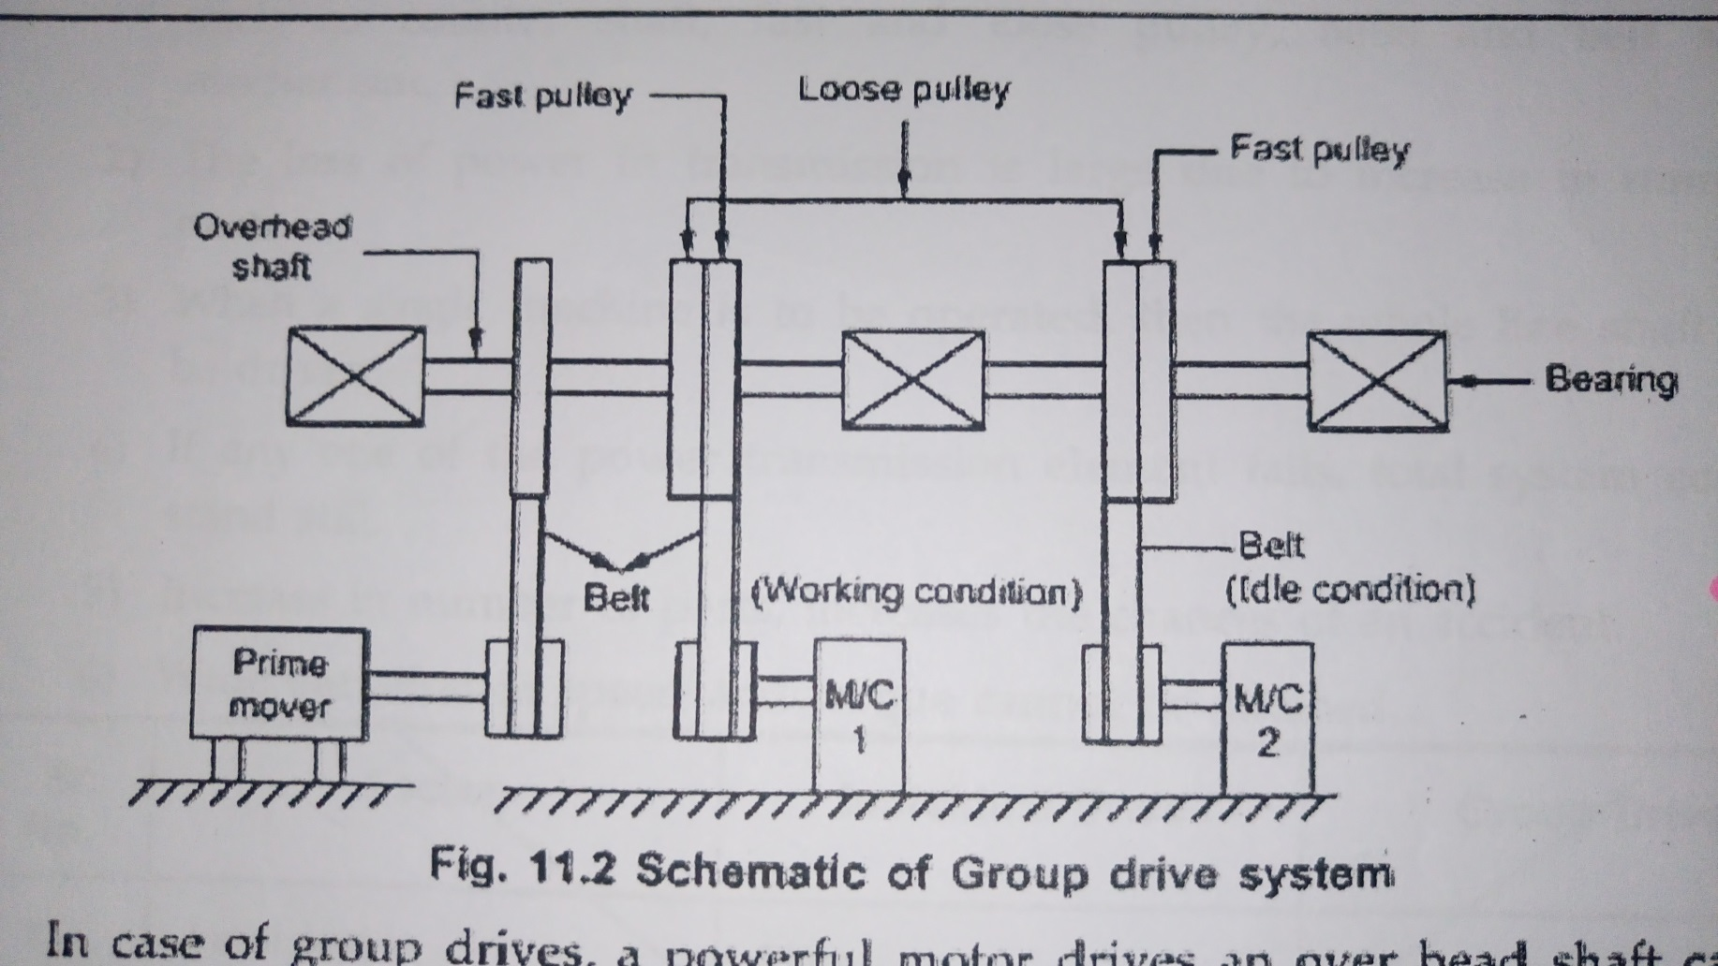
Group Electric drives

Slide 43
Group Electric drives
Consists of single motor, which drives one or more line shafts supported on bearings
Line shafts may be fitted with either pulleys and belts or gears ie a group of machines may be operated
Also called a shaft drives

Slide 44
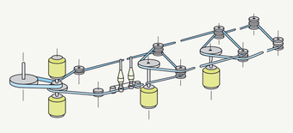
Group Electric drives

Slide 45
Group Electric drives
Advantages
1.Single large motor can be used instead of number of small motors
2.Rating of single motor can be reduced due to increased efficiency and power factor
3.Less maintenance
4. Number machines can be increased
5.Less floor pace is required

Slide 46
Types of Electric Drives
Disadvantages:
In group drive speed control of individual machine is difficult using stepped pulleys, belts etc..
Owing to the use of line shafting pulleys and belts group drive does not give good appearance and is also less safe to operate.
The possibility of installation of additional machines to the existing system in group drive is limited.
If at a certain instance all the machines are not in operation , then the motor will at low capacity and therefore operation efficiency will be low.
If a fault occurs in the main machine then all the operations will be effected.
Applications:
Grain processing industries
Food grinding mills
Paper mills
Textile mills, Workshops, etc.

Slide 47
Types of Electric Drives
Individual drive:
In individual drive a single electric motor is used to drive one individual machine. i.e. In individual drive each working machine has the individual main machine.
Example: single-spindle drilling machines and various types of electrical hand tools and simple types of metal working tools. Applications: Drill machines, Lathe machines, etc.
Advantages:
Installation of individual drive is easy.
If a fault is occurred in one main machine then the whole operations are not effected because it has individual main machines.
Each main machine can be effectively utilized at rated capacity.
Full control and desired operation of each machine is obtained because of different machines are driven with their respective individual drive.
Machines can be located at convenient places

Slide 48
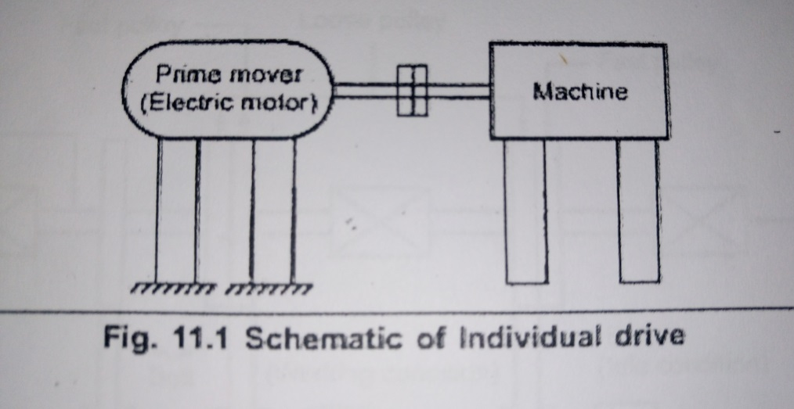
Individual Electric drives
Each individual machine is driven by separated motors
Eg. Single spindle machines and lathe

Slide 49
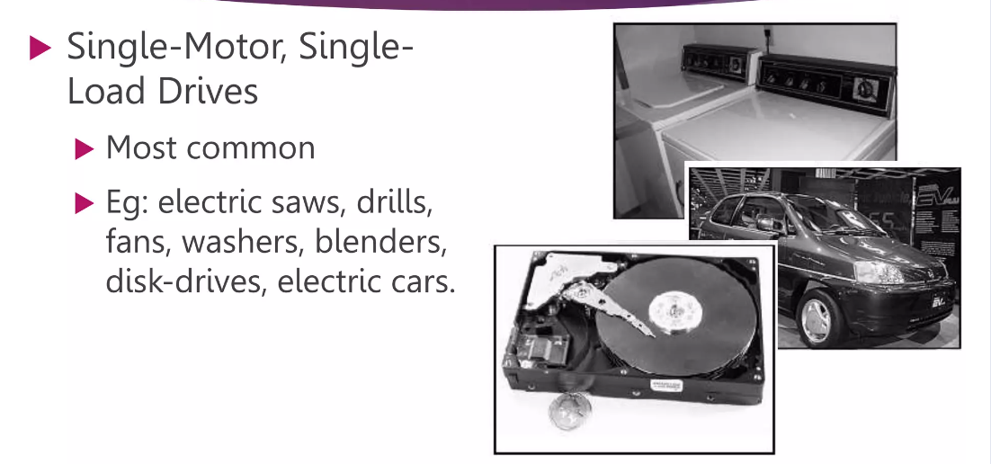

Slide 50
Individual Electric drives
Advantages
1.Economy of power
2.Less maintenance
3.Can be operated independently
4.Large variation of speed can be attained
5.Transmission losses are less
6.If one motor is fails it does not affect other
7.Flaxebilitty in layout workshop is possible
Disadvantages
1.Initial cost is more
2.More space is required

Slide 51
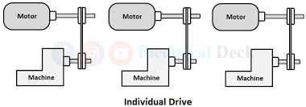
Types of Electric Drives
Disadvantages:
Cost is high because in this type of drive the number of machines required is high.
More space is required because of each working machine has its individual main machine.

Slide 52
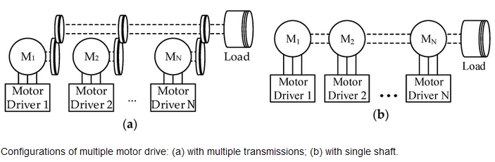
Types of Electric Drives
Multimotor drive:
A mechanism in which separate motors are used for operating different parts of the same machine is known as a multi-motor electric drive.
Multi-motor drives means the number of operations are required to perform a task. Example: The operation of CRANE.

Slide 53
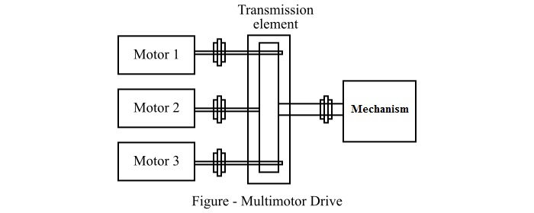
Types of Electric Drives
Advantages:
Multimotor drives provide better control of process.
With the help of multimotor drives, a complicated process can be automated.
In a multimotor drive, each machine is driven by a separate motor. Hence it can be individually started and stopped as desired.
In multimotor drives, the absence of belts and line shafts greatly reduces the power loss and risk of accidents.
The layout of multimotor drive is flexible in the installation of different machines.

Slide 54
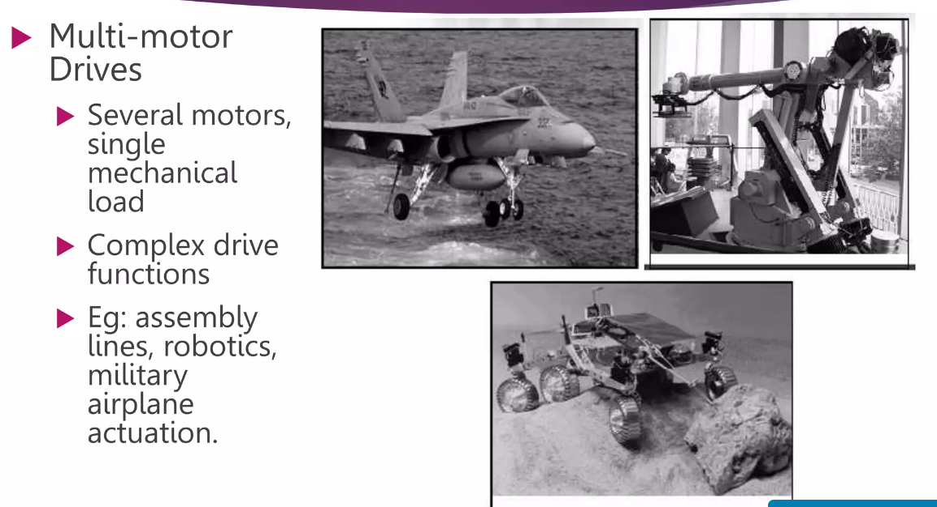

Slide 55
Types of Electric Drives
Disadvantages:
Multimotor drives involve high initial cost.
The maintenance of one motor causes disturbance to the entire process.
Applications:
Hoists
Lifts
Cranes
Long travel motion applications
Cross travel motion applications, etc.

Slide 56
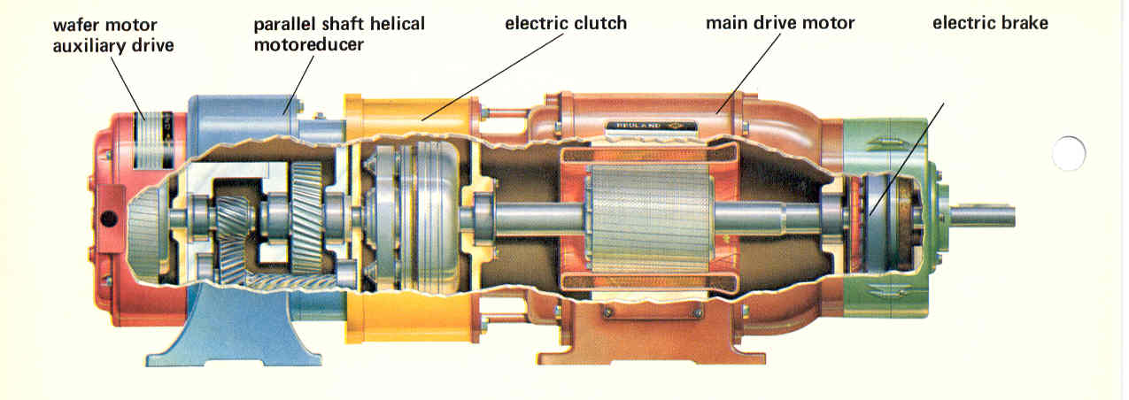
Multi motor Electric drives

Slide 57
Multi motor Electric drives
There are several drives, each of which to actuate one of the working parts of the driven mechanism
Complicated machine tools, paper making machines, rolling mills etc.
Three drives- vertical movement, horizontal movement and forward movements of load
Traction drive of electric motor drive- 4 to 8 motors

Slide 58
Comparison between DC and AC drives
DC DRIVES | AC DRIVES
The power circuit and control circuit is simple and inexpensive | The power circuit and control circuit are complex
It requires frequent maintenance | Less Maintenance
The commutator makes the motor bulky, costly and heavy | These problems are not there in these motors and are inexpensive, particularly squirrel cage induction motors
Fast response and wide speed range of control, can be achieved smoothly by conventional and solid state control | In solid state control the speed range is wide and conventional method is stepped and limited
Speed and design ratings are limited due to commutations | Speed and design ratings have upper limits

Slide 59
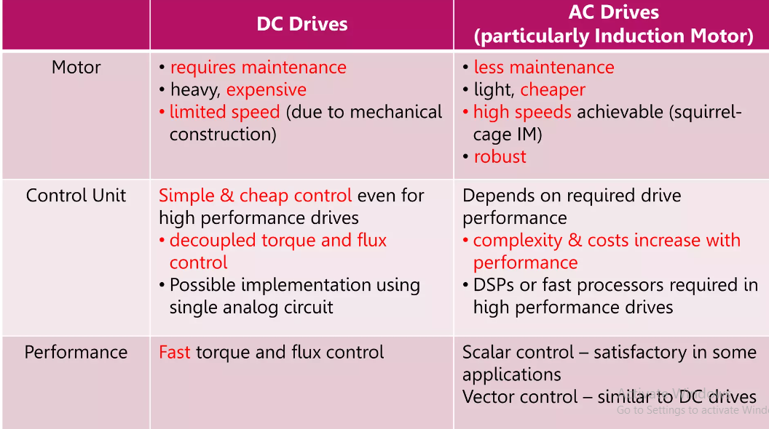

Slide 60
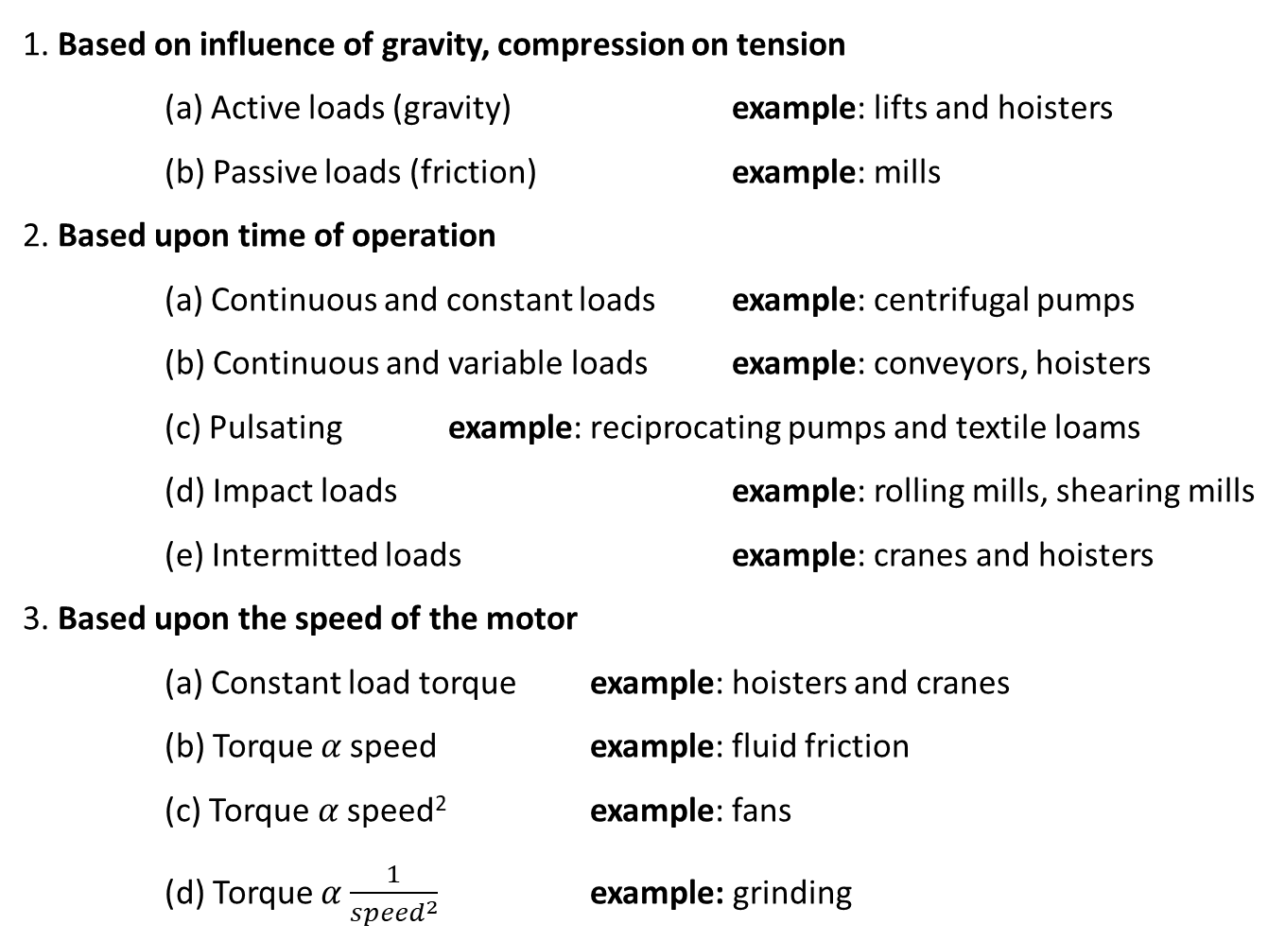
Types of Loads
1. Based on influence of gravity, compression on tension
(a) Active loads (gravity) example: lifts and hoisters
(b) Passive loads (friction) example: mills
2. Based upon time of operation
(a) Continuous and constant loads example: centrifugal pumps
(b) Continuous and variable loads example: conveyors, hoisters
(c) Pulsating example: reciprocating pumps and textile loams
(d) Impact loads example: rolling mills, shearing mills
(e) Intermitted loads example: cranes and hoisters
3. Based upon the speed of the motor
(a) Constant load torque example: hoisters and cranes
(b) Torque 𝛼 speed example: fluid friction
(c) Torque 𝛼 speed² example: fans
(d) Torque 𝛼 $\frac{1}{{speed}^{2}}$ example: grinding

Slide 61
Characteristics of Different types of Loads
One of the essential requirements in the section of a particular type of motor for driving a machine is the matching of speed-torque characteristics of the given drive unit and that of the motor.
Therefore the knowledge of how the load torque varies with speed of the driven machine is necessary. Different types of loads exhibit different speed torque characteristics.
However, most of the industrial loads can be classified into the following four categories.
Constant torque type load
Torque proportional to speed (Generator Type load)
Torque proportional to square of the speed (Fan type load)
Torque inversely proportional to speed (Constant power type load)

Slide 62

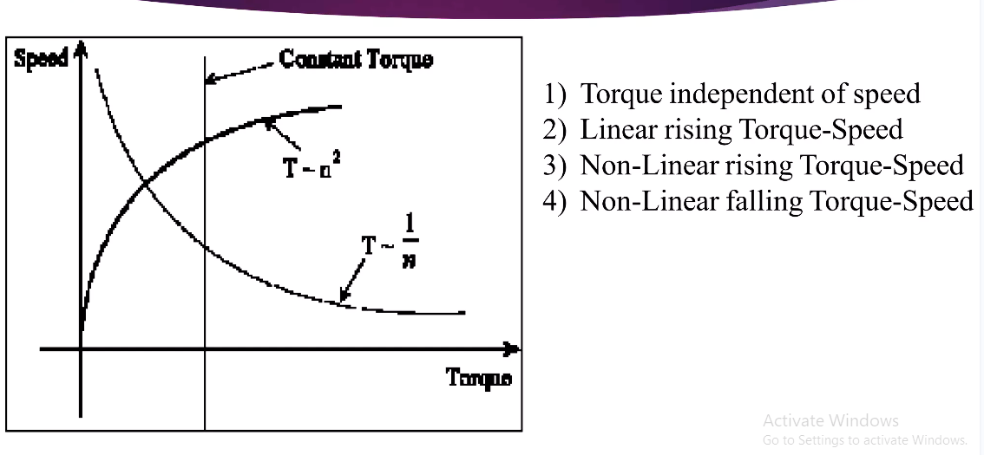

Slide 63
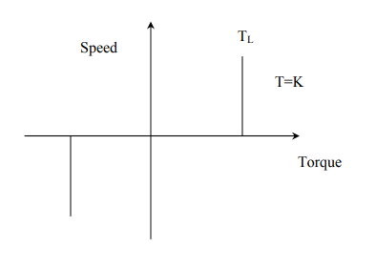
Constant Torque characteristics:
Most of the working machines that have mechanical nature of work like shaping, cutting, grinding or shearing, require constant torque irrespective of speed. Similarly cranes during the hoisting and conveyors handling constant weight of material per unit time also exhibit this type of characteristics.

Slide 64
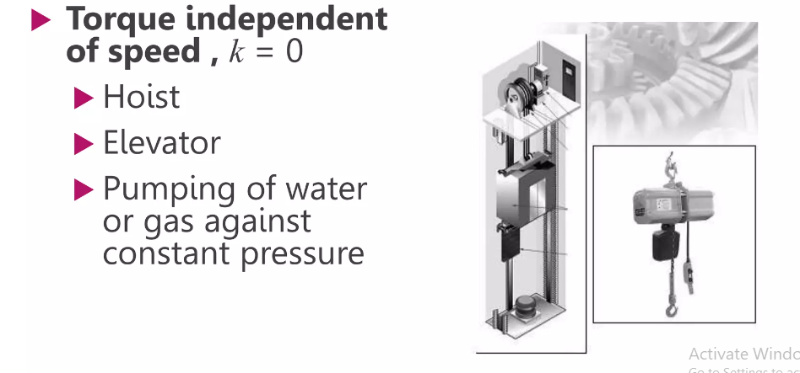

Slide 65
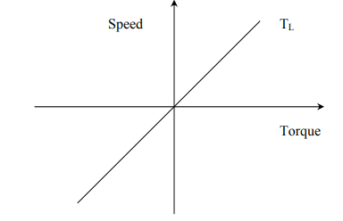
Torque Proportional to speed:
Separately excited dc generators connected to a constant resistance load, eddy current brakes have speed torque characteristics given by T=kω

Slide 66
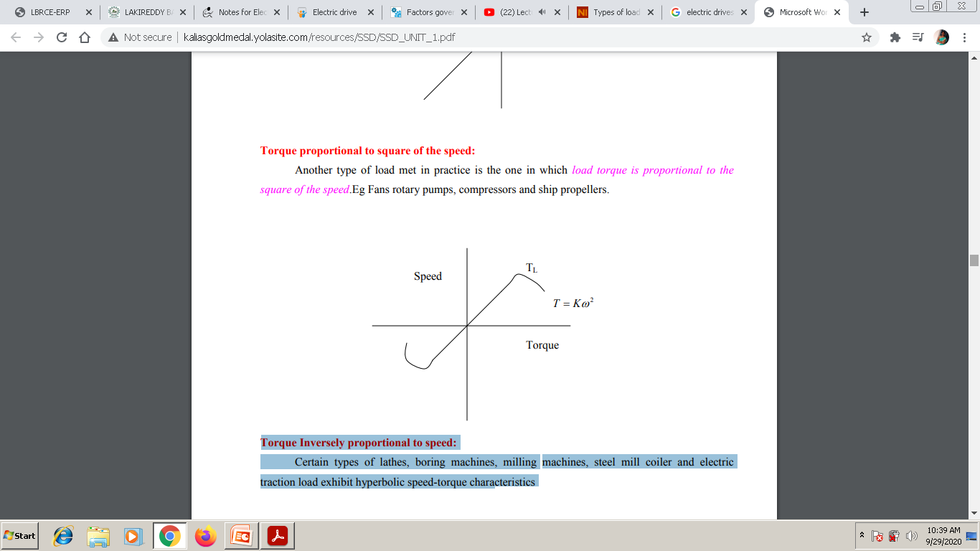
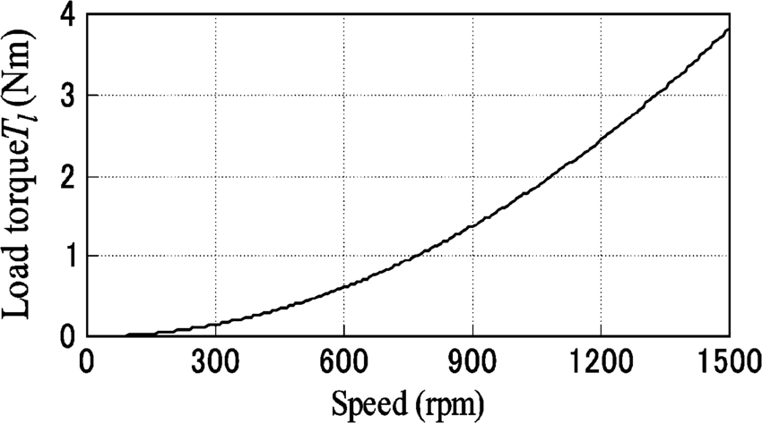

$$T=Kw^{2}$$

Slide 67
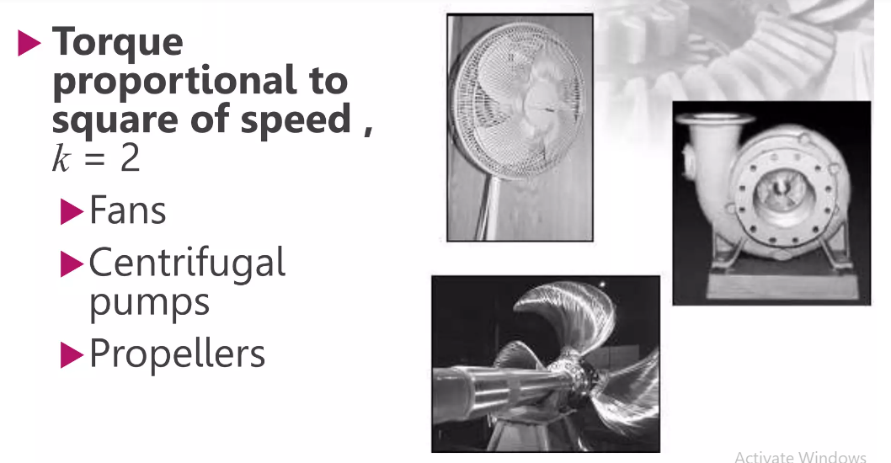

Slide 68
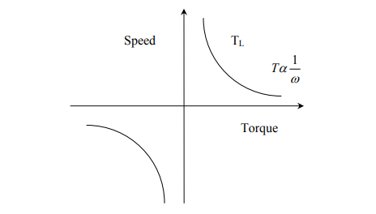
Torque Inversely proportional to speed:
Certain types of lathes, boring machines, milling machines, steel mill coiler and electric traction load exhibit hyperbolic speed-torque characteristics

Slide 69
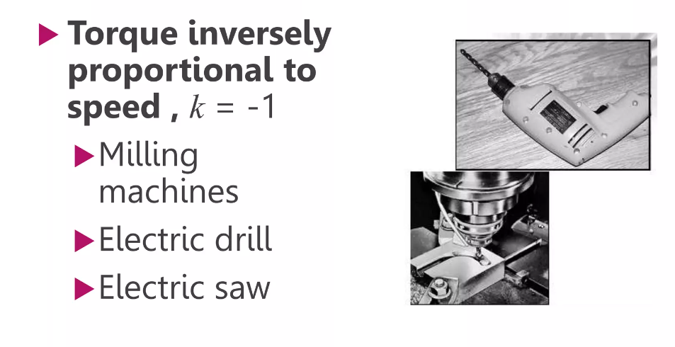

Slide 70

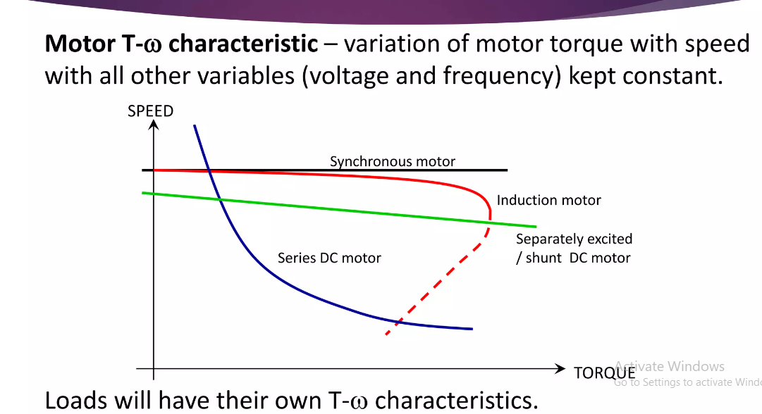

Slide 71
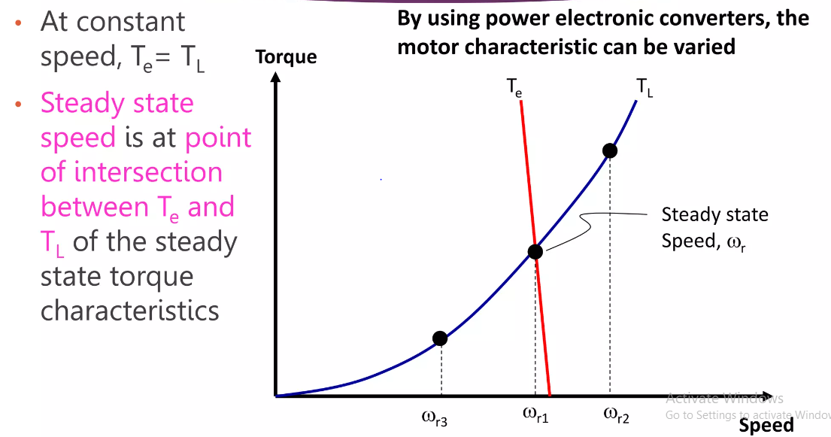

Slide 72
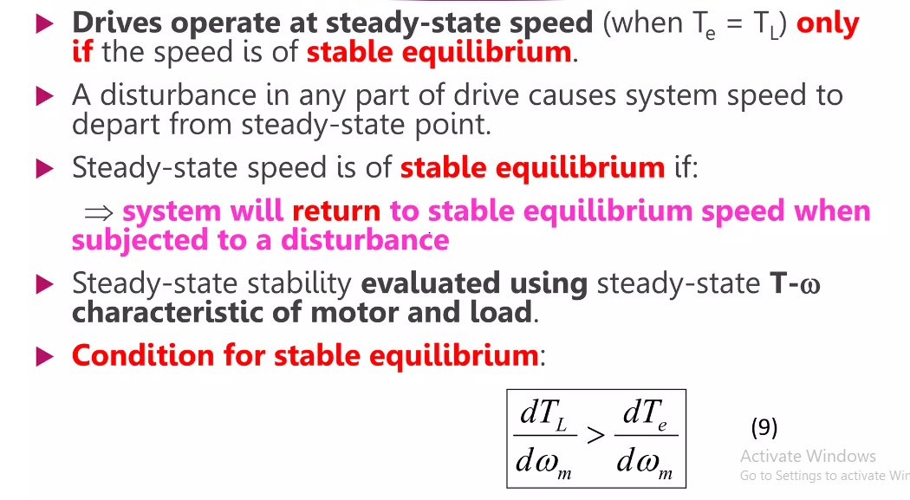

Slide 73
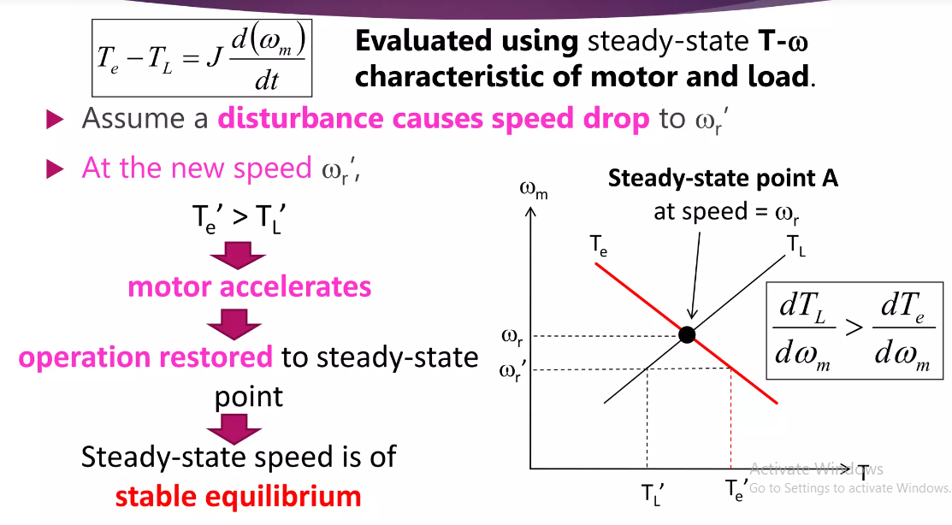

Slide 74
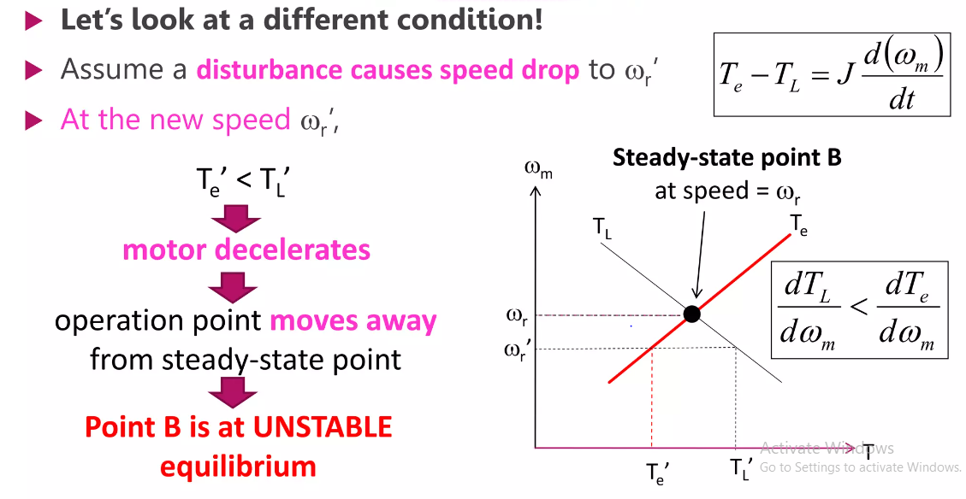

Slide 75

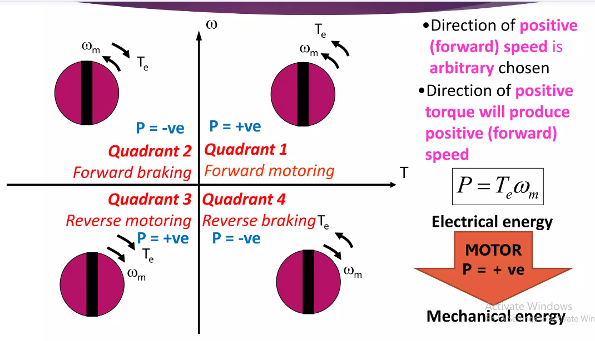

Slide 76
Four Quadrant Operation of Drives
Four Quadrant Operation of any drives or DC Motor means that the machine operates in four quadrants. They are Forward Braking, Forward motoring, Reverse motoring and Reverse braking.
A motor operates in two modes – Motoring and Braking. A motor drive capable of operating in both directions of rotation and of producing both motoring and regeneration is called a Four Quadrant variable speed drive.
In motoring mode, the machine works as a motor and converts the electrical energy into mechanical energy, supporting its motion.
In braking mode, the machine works as a generator and converts mechanical energy into electrical energy and as a result, it opposes the motion.
The Motor can work in both, forward and reverse directions, i.e., in motoring and braking operations.
The product of angular speed and torque is equal to the power developed by a motor.

Slide 77
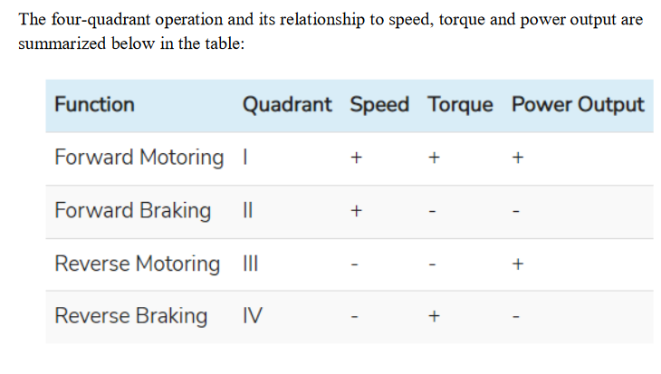

Slide 78

Four Quadrant Operation of Drives
For the multi-quadrant operation of drives, the following conventions about the signs of torque and speed are used.

Slide 79
Four Quadrant Operation of Drives
When the motor is rotated in the forward direction the speed of the motor is considered positive.
The drives which operate only in one direction, forward speed will be their normal speed.
In loads involving up and down motions, the speed of the motor which causes upward motion is considered to be in forward motion. For reversible drives, forward speed is chosen arbitrarily.
The rotation in the opposite direction gives reverse speed which is denoted by a negative sign.
In the I quadrant, power developed is positive and the machine is working as a motor supplying mechanical energy. The I (first) quadrant operation is called Forward Motoring.

Slide 80
Four Quadrant Operation of Drives
II (second) quadrant operation is known as Braking. In this quadrant, the direction of rotation is positive, and the torque is negative, and thus, the machine operates as a generator developing a negative torque, which opposes the motion.
The kinetic energy of the rotating parts is available as electrical energy which may be supplied back to the mains. In dynamic braking, the energy is dissipated in the resistance.
The III (third) quadrant operation is known as the reverse motoring. The motor works, in the reverse direction. Both the speed and the torque have negative values while the power is positive.
In the IV (fourth) quadrant, the torque is positive, and the speed is negative. This quadrant corresponds to the braking in the reverse motoring mode.

Slide 81

Operation of hoist in Four Quadrants
Direction of motor & load torques and direction of speed are marked by arrows.

Slide 82


Slide 83


Slide 84
Operation of hoist in Four Quadrants
A hoist consists of a rope wound on a drum coupled to a motor shaft. One end of a rope is tied to a cage which is used for transporting material. Other end of the rope has a counter weight.
Weight of the counter weight chosen higher than the weight of an empty case but lower than a fully loaded cage.
Load torque T_{L} in quadrants I & IV represent speed torque characteristics of the loaded hoist. This torque is the difference of torques due to loaded hoist & counter weight.
Load torque T_{L} in quadrants II & III is the speed-torque characteristics of an empty hoist. This torque is due to the difference in torque of counter weight & empty hoist. This is negative because the counter weight is always higher than the empty cage.

Slide 85
Operation of hoist in Four Quadrants
The quadrant I operation – hoist requires the movement of the cage upward, which corresponds to the +ve motor speed which is in CCW (counter clockwise) direction.
It will be obtained if motor produce +ve torque in CCW direction equal to T_{L}. Since developed power is +ve, this is forward motoring operation.
Quadrant IV operation is obtained when a loaded cage is lowered. Since the weight of the loaded cage is > the counter weight.
In order to limit the speed of the cage within a safe value, motor must produce a +ve torque T = T_{L} in anti clockwise direction. Both power & speed are –ve, drive is in reverse braking.
Quadrant II is obtained when an empty cage is moved up since a counter weight is heavier than a empty cage, it is able to pull it up.
In order to limit the speed to safety value, motor must produce braking torque = T_{L} in clockwise direction. Since speed is +ve, developed power is, negative. It is forward breaking operation.

Slide 86
Operation of hoist in Four Quadrants
Quadrant III : empty cage is lowered since empty cage weight is < counter weight motor produce a torque in clockwise direction. Since speed is –ve & developed power is +ve, this is reverse motoring operation.
Applications of Four Quadrant Operation
Compressor, pump and fan type load requires operation in the I quadrant only. As their operation is unidirectional, they are called one quadrant drive systems.
Transportation drives require operation in both directions.
If regeneration is necessary, application in all four quadrants may be required. If not, then the operation is restricted to quadrants I and III, and thus dynamic braking or mechanical braking may be required.
In hoist drives, a four-quadrant operation is needed.

Slide 87

Constant Torque and Constant Power Operation

Slide 88


Slide 89


Slide 90


Slide 91


Slide 92


Slide 93


Slide 94


Slide 95


Slide 96


Slide 97
The equilibrium point will be termed as stable state when the operation will be restored to it after a small departure from it due to disturbance in the motor or load.
Due to disturbance a reduction of speed at new speed, electrical motor torque is greater than the load torque, consequently motor will accelerate and operation will be restores to point A.
similarly an increase in speed caused by a disturbance will make load torque greater than the motor torque, resulting into deceleration and restoring of operation to point A.

Slide 98

Now consider equilibrium point B which is obtained when the same motor drives another load as shown in the figure.
A decrease in speed causes the load torque to become greater than the motor torque, electric drive decelerates and operating point moves away from point B.
Similarly when working at point B and increase in speed will make motor torque greater than the load torque, which will move the operating point away from point B

Slide 99


Slide 100

Transient Stability Concept
In a synchronous motor drive, the steady-state speed and torque of the motor and load may be such that the steady-state stability criterion does not provide any reliable information regarding its stability. Therefore it is neces­sary to study its Transient stability in Electrical Drives.
It is well known that a synchronous motor is very sensitive to sudden changes of load and prone to what is called hunting.
The oscillatory behaviour of a rotor about a mean torque angle position is called hunting.
The power developed by synchronous motor, neglecting armature resistance is
Let the ma­chine be operating at a power angle equal to δ, giving a power of P. The torque balance equation may be replaced by the power balance equation due to the constancy of speed.
$$P= \frac{EV}{X}sinδ$$

Slide 101
Transient Stability Concept
When a load is suddenly applied to the shaft of a synchronous motor there is a momentary slowing down of the motor.
This causes the rotor to fall back from its old position in order to develop the required torque. Till the rotor attains its new position, the rotor releases the kinetic energy to drive the increased load during retardation.
The rotor angle increases to a value where sufficient torque is developed to drive the load.
At this position, ro­tor speed is less than synchronous speed. The rotor does not remain at this new equilibrium position.
It has to be brought back to its synchronous speed by replenishing the kinetic energy released by the rotating mass. Therefore the torque angle increases further. The torque developed is more than the load torque.
Excess torque accelerates the rotor and eventually reduces the torque angle. The rotor may overshoot the equilibrium position.

Slide 102
Transient Stability Concept
The rotor thus oscillates like a torsional pendulum about the equilibrium position corresponding to new torque. The motor operation is stable when the torque angle changes within π/2.
However, during oscillations or hunting of the motor, there is a possibility that the motor has a torque angle greater than π/2.
The motor may be stable or may lose its stability. In such cases the stability of the drive can be estimated using equal area criterion.

Slide 103

As shown in Fig. in an unstable system, δ increases indefinitely with time and machine looses synchronism.
In a stable system, δ undergoes oscillations, which eventually die out due to damping.

Slide 104

Transient Stability Concept
A1 – Acceleration area
A2 – Deceleration area

Slide 105

Transient Stability Concept
A1 – Acceleration area
A2 – Deceleration area

Slide 106

Transient Stability Concept
Does the synchronous motor is stable or unstable for below Equal Area Criterion?

Slide 107
Load Equalisation in Electrical Drives
In some drive applications, load torque fluctuates widely within short intervals of time.
For example, in pressing machines a large torque of short duration is required during pressing operation, otherwise the torque is nearly zero.
Other examples are electric hammer, steel rolling mills and reciprocating pumps. In such drives, if motor is required to supply peak torque demanded by load, first motor rating has to be high. Secondly, motor will draw a pulsed current from the supply.
When amplitude of pulsed current forms an appreciable proportion of supply line capacity, it gives rise to line voltage fluctuations, which adversely affect other loads connected to the line.
In some applications, peak load demanded may form major proportion of the source capacity itself, as in blooming mills, then load fluctuations may also adversely affect the stability of source.

Slide 108

Load Equalisation in Electrical Drives

Slide 109
Load Equalisation in Electrical Drives
Above mentioned problems of fluctuating loads are overcome by mounting a flywheel on the motor shaft in non-reversible drives. Motor speed-torque characteristic is made drooping. Alternatively, by closed loop current control torque is prevented from exceeding a permissible value.
During high load period, load torque will be much larger compared to the motor torque. Deceleration occurs producing a large dynamic torque component (J dω_{m}/dt).
Dynamic torque and motor torque together are able to produce torque required by the load Because of Fig. Shapes of motor speed torque curves for deceleration, the motor speed falls.
During light load period, the motor torque exceeds the load torque causing acceleration Speed is brought back to original value before the next high load period.

Slide 110
Load Equalisation in Electrical Drives
Variation of motor and load torques, and speed for a periodic load and for a drooping motor speed-torque curve are shown in Fig.
It shows that peak torque required from the motor has much smaller value than the peak load torque.
Hence, a motor with much smaller rating than peak load can be used and peak current drawn by motor from the source is reduced by a large amount.
Fluctuations in motor torque and speed are also reduced. Since power drawn from the source fluctuates very little, this is called load equalisation.

Slide 111


Slide 112


Slide 113


Slide 114


Slide 115

Method of Load Equalization in Electrical Drives
In electrical drives, load equalization is achieved with the help of a flywheel. A flywheel is a wheel of heavyweight. This flywheel is attached to the shaft of the electric drive, and it acts as a reservoir of energy.
During the period of light loads, the flywheel stores extra energy received from the supply.
During periods of heavy loads, the speed of the electrical drive decreases. Under this condition, the flywheel redistributes the stored energy to meet the load demand.
Hence, the electric power drawn from the supply remains constant throughout the operation of the drive.

Slide 116


Slide 117


$$w_{m}=w_{m0}−\left(\frac{w_{m0}−w_{mr}}{T_{r}}\right)T$$

Slide 118

Load Equalisation in Electrical Drives

Slide 119

Load Equalisation in Electrical Drives
In variable speed and reversible drives, a flywheel cannot be mounted on the motor shaft, as it will increase transient time of the drive by a large amount.
If motor is fed from a motor-generator set (Ward-Leonard Drive), then flywheel can be mounted on the shaft of the motor-generator set.
This arrangement of Load Equalisation in Electrical Drives on the source, but not the load on motor. Consequently, a motor capable of supplying peak-load-torque is required.
Moment of inertia of the flywheel required for Load Equalisation in Electrical Drives is calculated as follows: Assuming a linear motor-speed-torque curve in the region of interest.
$J=WR^{2}$ Kg-m²
Where J is moment of inertia of the flywheel and W is weight of the flywheel and R is radius of the flywheel

Slide 120



Slide 121
Size of Motor
From the classes of duty the motor rating is selected. A motor can be selected for a given class of duty based on its thermal rating with due consideration to pull out torque i.e. the overload must be within the pull out torque. The various classes of duties are
1.Continuous duty
2 . Intermittent duty
3.Short time duty
Contd….

Slide 122

Contd….

Slide 123

Contd….

Slide 124

Contd….

Slide 125

Contd….

Slide 126


Contd….

Slide 127

Contd….

Slide 128

Contd….

Slide 129

Contd….

Slide 130

Contd….

Slide 131

Contd….

Slide 132

Contd….

Slide 133

Contd….

Slide 134

Contd….

Slide 135

Contd….

Slide 136

Contd….

Slide 137

Contd….

Slide 138

Contd….

Slide 139


